Slide 1
INVESTMENT CASE STUDY SUBMISSION

Slide 2
Abstract
Introduction: This case study is to explore investment patterns across various countries in different funding types and sectors. This helps ‘Spark Funds’ to take decision effectively based on the global trends derived from this study
Methods: The study was conducted on real investment data from crunchbase.com. Collected data sets were analyzed by python3.6 & Tableau software. Collected data consists of three main data tables.
1. companies.txt: A table with basic data of companies
2. rounds2.csv: A table with basic data related to funding
3. mapping xls: File which maps category_names to 8 main sectors
Results: The findings of this analysis indicates that investments are majorly done in ‘Others’ sector in top 3 English speaking countries which is within the investment range of 5-15 million USD.

Slide 3
Problem solving methodology
Read companies.txt
Read rounds2.csv
Merge and create
Master_frame
Data cleaning
Fund analysis:
Find average value of investments for each FT to derive suitable FT
Country analysis:
Find sum() investments based on derived FT to get top 9 countries
Extracting the primary_sector in a new column
Read mapping.xls
Replace 0 with ‘na’ In category list
Merge to master_frame
Find total investment done sector wise for each country
Find company which received highest investment company wise

Slide 4
Funding Type Analysis
This analysis is done to choose the best fund type in seed, angel, venture and private equity type. To derive the best funding type in between 5-15 million USD, followed below steps:
1. Convert units of 'raised_amount_usd‘ to million USD
2. Convert data type of the above column to float.
3. Find average Values of investments for each funding types by grouping the 'funding_round_type‘
Result: It is derived that ‘venture’ FT is the suitable one among seed, angel, venture and private equity types, which falls in between 5-15 million USD. Average investment value for ‘venture’ FT is derived as 11.097906 whereas, for seed: 0.748215, angel: 0.968618 and private equity: 60.568973

Slide 5
Country Analysis
This analysis is done to choose the top 9 countries with the highest amount of funding for the chosen ’venture’ fund type. From the top 9 countries top 3 English speaking countries are selected as per the business strategy. To derive the top9 countries, followed below steps:
1. Filter master_frame with ‘funding_round_type’ == ‘venture’
2. Derive sum of 'raised_amount_usd‘ according to 'country_code'
3. Sort the values in descending order
Result: It is derived that USA, GBR & IND are top 3 English speaking countries which have received the highest funding.

Slide 6
Sector Analysis
This analysis is done to choose the best sectors to invest for the chosen ’venture’ fund type. This analysis is done for all the 3 countries USA, GBR and IND. To derive the best sectors, followed below steps:
1. Extracted the primary sector of each category list from the category_list column in master_frame
2. Using the mapping file the above primary sectors are mapped to main sectors.
3. Create 3 new dataframes D1, D2 & D3 by filtering with the country, ft type as ‘venture’ and investment amount in between 5-15 million USD
Assumptions: Others column in mapping file is ignored with an assumption that is doesn’t adds any value to the analysis done.
Result: It is derived that ‘others’ sector is derived as most valued sector in all three countries

Slide 7
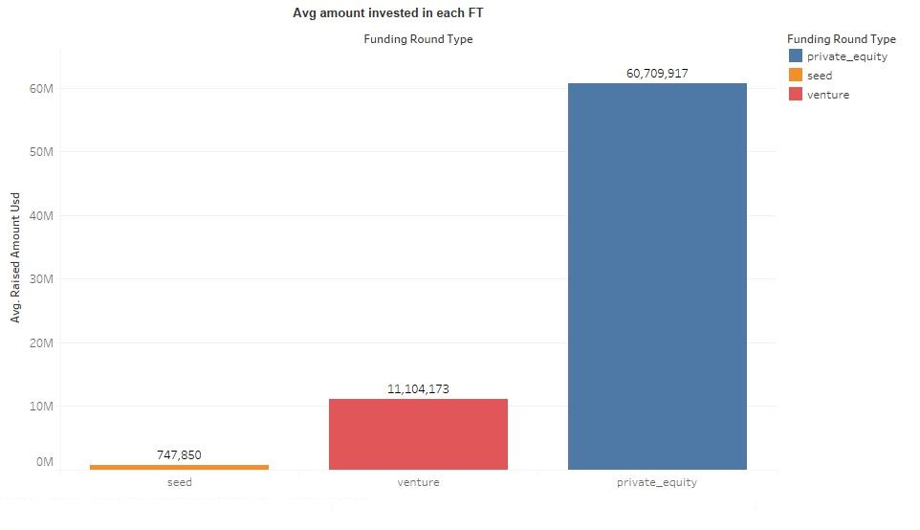
Fund analysis chart

Slide 8
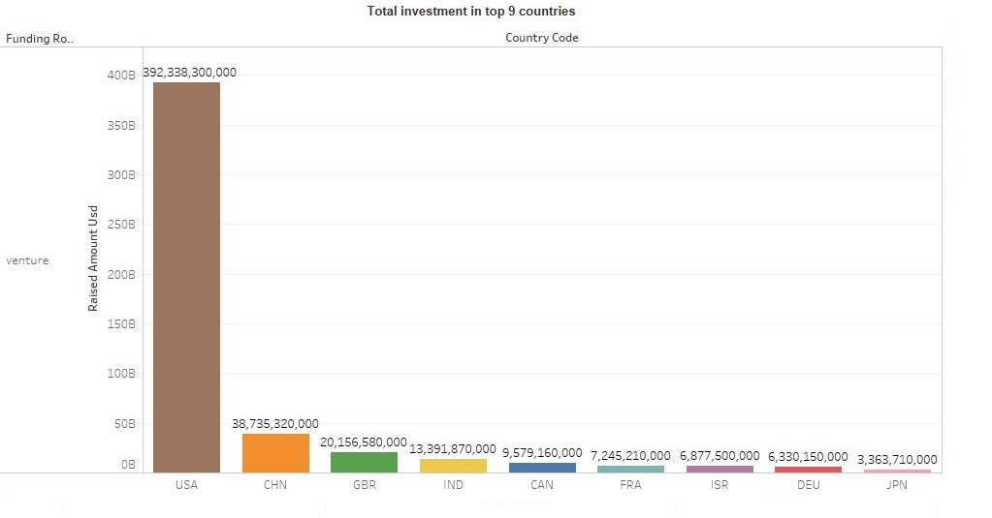
Country analysis chart

Slide 9
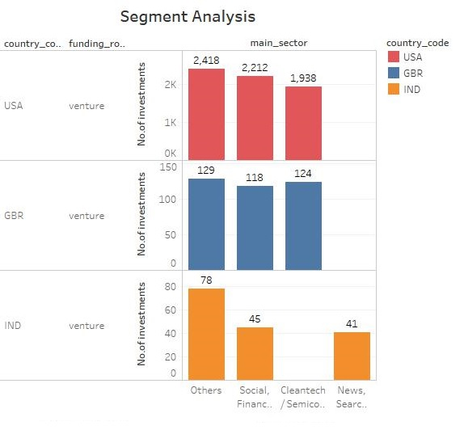
Sector analysis chart

Slide 10
Conclusions
The findings indicated that venture funding type is the FT which falls in between 5-15 million USD. Drilling down ‘others’ is the sector where most investments are done across the top 3 countries USA, GBR & IND.
Below are the companies where more investments are done under ‘others’ sector
USA: AirTight Networks
GBR: Electric Cloud
IND: Myntra

